Slide 1
Cache Memory
Cache Replacement Algorithms

Slide 2
Introduction
Memory hierarchy
Registers Memory Disk
Cache memory is a small amount of fast memory
Placed between two levels of memory hierarchy
» To bridge the gap in access times
Between processor and main memoi'y (our focus)
Between main memory and disk (disk cache)
Expected to behave like a large amount of fast memory

Slide 3
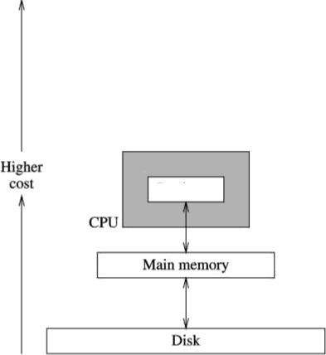

Introduction (cont'd)
Registers
Cache memory
CPU
Faster
Registers
Main memory
Disk cache
Disk
(
(b

Slide 4
Cache Memory
Cache memory is a small-sized type of volatile computer memory.
provides high-speed data access to the processor and stores frequently used computer programs, applications, and data.
It acts as a buffer between the CPU and the main memory (RAM), significantly improving the speed of data retrieval.
By storing copies of frequently accessed data, cache memory reduces the time it takes for the CPU to fetch data, thus enhancing overall system performance.
It consists of multiple levels (L1, L2, L3), with L1 being the fastest and smallest.

Slide 5
How Cache Memory Works
Prefetch data into cache before the processor
needs it
Need to predict processor future access requirements
» Not difficult owing to locality of reference
Important terms
Miss penlty
Hit ratio
Miss ratio (1 — hit ratio)
Hit time

Slide 6
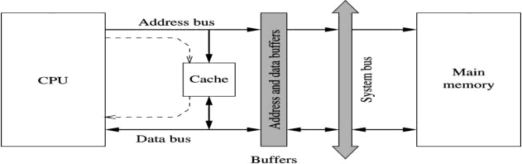
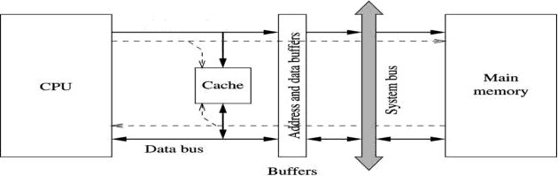
How Cache Memory Works (cont'd)
cable
-'=•=
Cache read operation

Slide 7
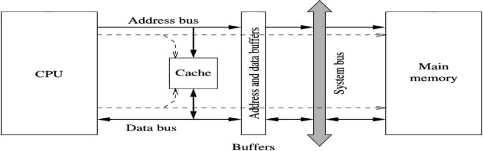
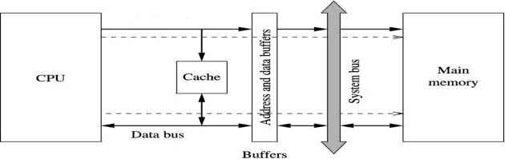
How Cache Memory Works (cont'd)
Cache write operation
enable
--••.

Slide 8
Why Cache Memory Works
Example
for {i=0; i<M; i++)
for(j=0; j<N; j++)
X[i][j] = X[i][j] + K;
Each element of X is double (eight bytes)
Loop is executed (MIN) times
» Placing the code in cache avoids access to main memory
— Repetitive use (one of the factors) Temporal locality
» Prefetching data
Spatial locality

Slide 9
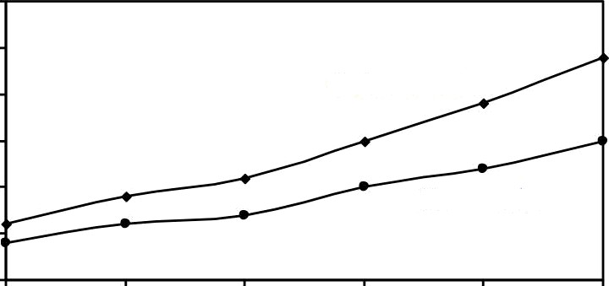
How Cache Memory Works (cont'd)
250
time (ms
Column-order
200
Execution
130
100
Row—order
50
()
600
son
8
8
Matrix size

Slide 10
Cache Design Basics
On every read miss
A fixed number of bytes are transfea&
» More than what the processor needs
— Effective due to spatial locality
Cache is divided into blocks of & bytes
» b-bits are needed as offset into the block
ft = logo
» Block are called cache lines
Main memory is also divided into blocks of same size
AdAess is divided intn two parts

Slide 11
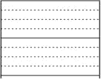
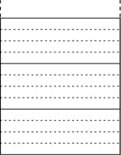
Cache Design Basics (cont'd)
k4eznory address
B -- 4 bytes
b = 2 bits
6 52R
actdcsee
\ 6.383
1 6.382
Cache
line
2G47
2O4h
'
'
'
8
3
2
0
4
0
Byte 3
Byte 2
Byte I Bytc O
0
Byte offs
Address partition

Slide 12
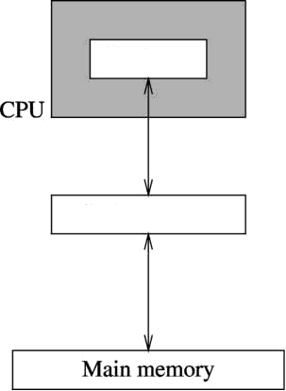


Cache Design Basics (cont'd)
Transfer between main
memory and cache
In units of blocks
Transfer between main
memory and cache
< In units of words
wo«i
Cache memory
Need policies for
Block
Mapping function
< Block replacement
+ Write policies

Slide 13

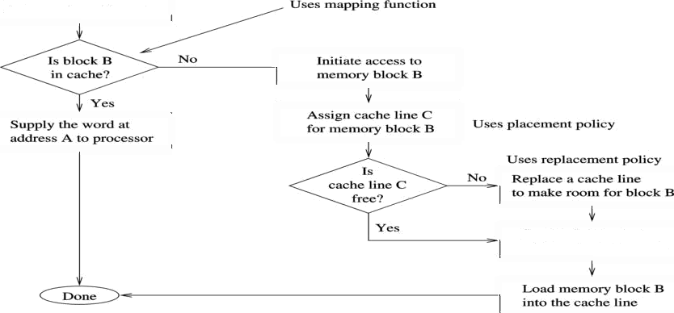
Cache Design Basics (cont'd)
Read cycle operations
memory adctrese A
find memory block D chat contains addzoss A
Supply che wor‹i5 ac
adDmss A uo poacessor

Slide 14
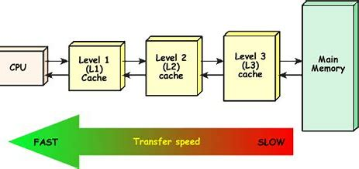
Levels Of Cache
Level 1 cache (L1) is integrated within the CPU, allowing it to operate at the same speed as the processor. It consists of separate instruction and data caches for efficient processing.
Level 2 cache (L2) may be located inside or outside the CPU and can be dedicated or shared among cores. It is larger than L1 but slower in speed.
Cache memory, particularly level 3, enhances the performance of CPU processing by serving as a shared resource for all cores. It is slower than L1 and L2 caches but faster than RAM.

Slide 15

Mapping Function
Deternines how memory blocks are mapped to cache lines. Refers how data is stored in cache from main memory.
Three types
Direct mapping
» Specifies a single cache line for each memory block
Set-associative mapping
» Specifies a set of cache lines for each memory block
» No restrictions
— Any cache line can be used for any memory block

Slide 16
Mapping Function
Direct Mapping:-is the simplest cache mapping technique.
Each memory address maps to a specific cache line determined by the
formula:
Cache Line = (Memory Address)mod(Number of Cache Lines)
Advantages:-
Simple to implement
Fast access time
Disadvantages:-
Conflict misses can occur if multiple addresses map to the same line.
Example: If a cache has 4 lines and memory addresses 0, 4, and 8 are accessed, they all map to line 0, causing a conflict.

Slide 17
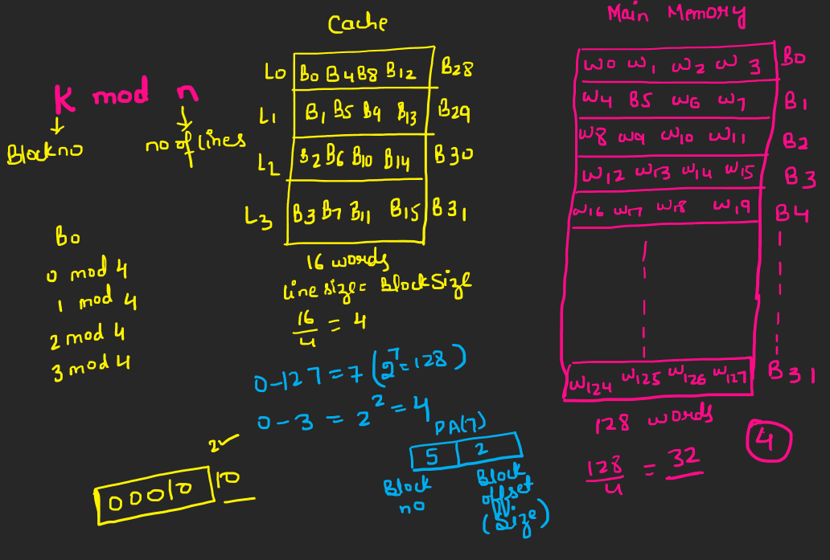
Direct Mapping

Slide 18
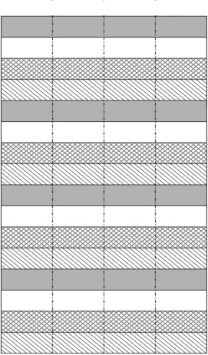


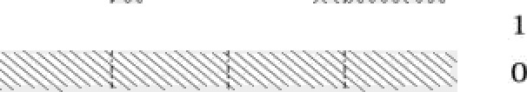
Mapping Function (cont'd)
Blnek
address Byte 3 Byte 2 1 Byte I
i4 13
Mapped to
cache line
Byte 0
Byte 3 • Byte 2 • Byte I • Byte
t0 9 B
2
3
2
0
6
Cache memory
4
3
Z
0
Islam memory

Slide 19
Associative Mapping
In associative mapping both the address and data of the memory word are stored.
The associative mapping method used by cache memory is very flexible one as well as very fast.
This mapping method is also known as fully associative cache
.
Advantages of associative mapping
Associative mapping is fast,easy to implement.
provides lot of flexibility & also helps in reducing conflict misses.
Disadvantages of associative mapping
Cache Memory implementing associative mapping is expensive as it requires to store address along with the data.
Implementing associative mapping can be expensive due to requirement of complex hardware for searching and managing cache line.

Slide 20
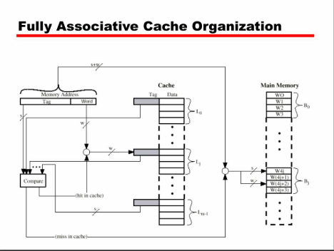
Associative Mapping
.

Slide 21
Replacement Policies
We invoke the replacement policy
When there is no place in cache to load the memory block
Depends on the actual placement policy in effect
Direct mapping does not need a special replacement policy
» Replace the mapped cache line
Several policies for the other two mapping functions
» Popular: LRU (least recently used)
» Random replacement
» Less interest (FIFO, LFU)

Slide 22
Replacement Policies
Least Recently Used (LRU): Replaces the least recently accessed item.
First-In-First-Out (FIFO): Replaces the oldest item in the cache.
Least Frequently Used (LFU): Replaces the least frequently accessed item
Most Frequently Used(MFU): Replaces the most frequently accessed item.
Each algorithm has its specific use cases and performance implications.

Slide 23
Replacement Policies (cont'd)
LRU
Expensive to implement
» Particularly for set sizes more than four
Implementations resort to approximation
Pseudo-LRU
» Partitions sets into two groups
Maintains the group that has been accessed recently
Requires only one bit
» Requires only (W-1) bits (W = degree of asSOCiativity)
PowerPC is an example lDetails later

Slide 24
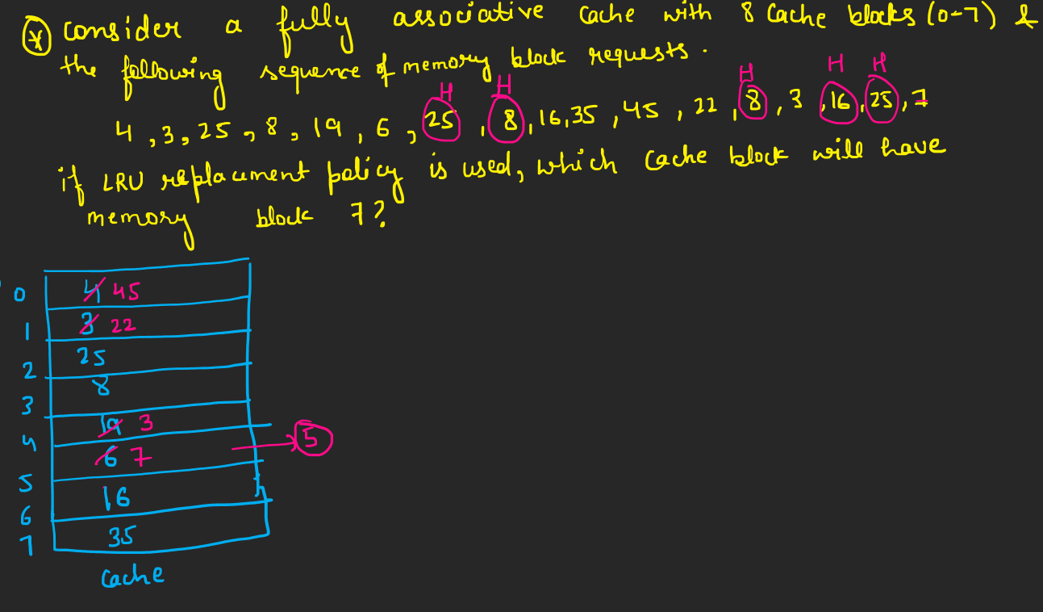
LRU

Slide 25
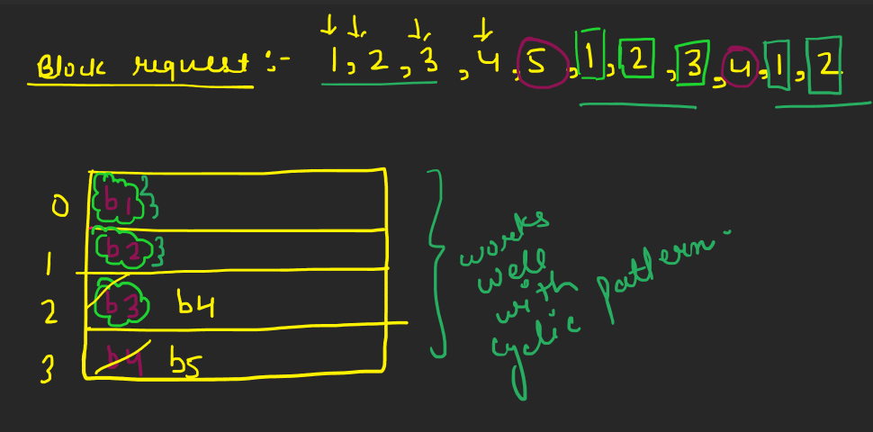
MRU:-Most Recently USED

Slide 26
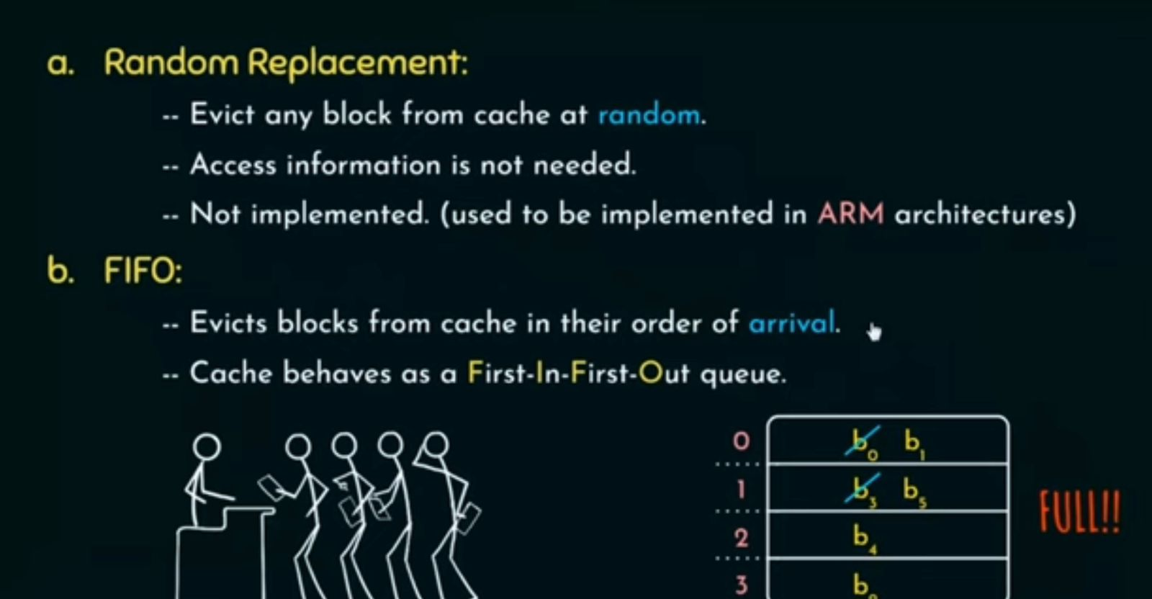

Slide 27
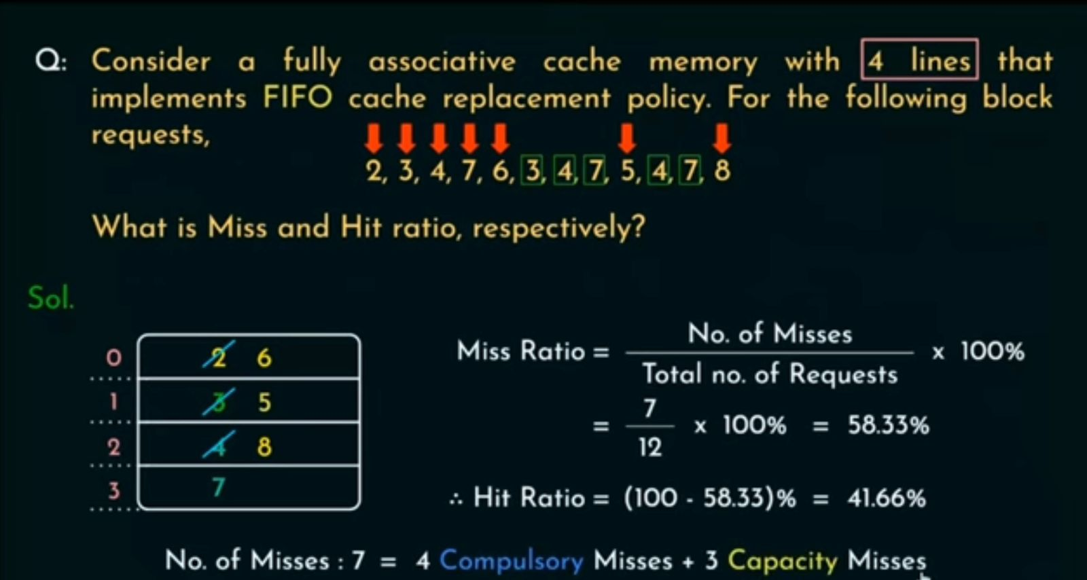

Slide 28
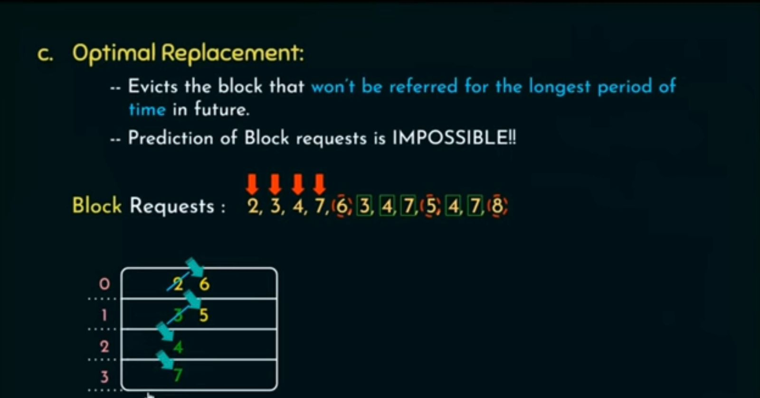

Slide 29
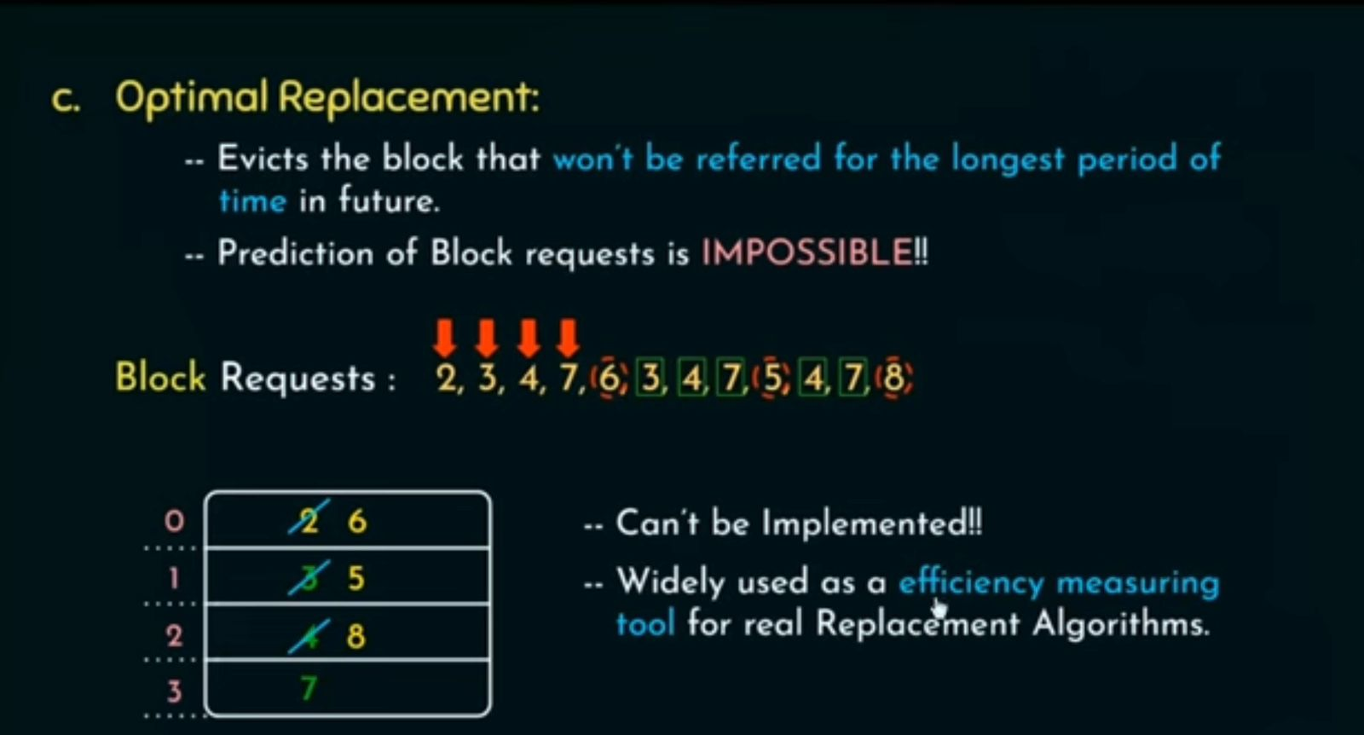

Slide 30
Replacement Policies (cont'cI)
Pseudo-LRU
implementation
B0 bit:
(L0, LI) or (L2, L3)?
B0=0
B0=1
B1 bit: L0 or Ll?
B2 bit: L2 or L3?
B1 = 0
BI = 1
B2=0
B2 = l
Cache line
L0
Cache line
L1
Cache line
L2
Cache line
L3

